Slide 1
CHAIN REACTION
TITLE -
By:
Riya phandhare
Aarnav phatak
Sachin bhujbal
Prathmesh jaiswal
Shivam gaikwad
Nikhil kolhe

Slide 2
Abstract
This project is aimed at presenting the thinking behind the design of a game and explaining how we adapt the metaphor/image of CHAIN REACTION to devise the game. The players are guided to choose correct and suitable triggers to construct orbs in a blank cell with continuous motivation, and thus, achieve the game’s objective. The purpose of this study is to use the procedures suggested in the Creative Problem Solving (CPS) model , as the analytical model in order to comprehend the circumstances of game operations during the processes of solving problem and explore the design thinking of game interaction.

Slide 3
Introduction
This is a strategic game for two to six players. In this game, players have to take control of the board by eliminating opponents orbs. At the end, the one who takes the control over the whole board will wins.
Players take it in turns to place their orbs in a cell. Once a cell has reached a specific number of orbs, the cell explodes adding each orb to the adjacent cells and claiming these cells for that player.
Players may only place their orbs in a blank cell or in a cell that contains orbs of his/her own color. As soon as a player eliminates all his opponent's orbs, he/she wins the game.

Slide 4
Components
Tkinter - Tkinter is a Python binding to the Tk GUI toolkit. It is the standard Python interface to the Tk GUI toolkit, and is Python's de facto standard GUI.
Software used - PyCharm
Programming language - Python

Slide 5
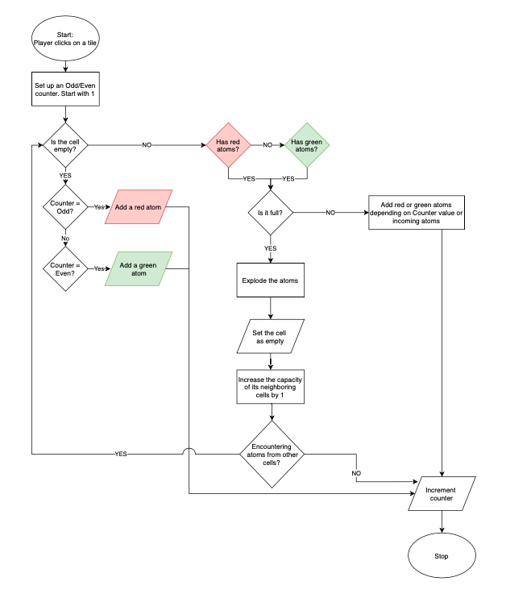
flowchart

Slide 6
Explanation
The Board of chain game is 9×6 as in dimension. The game play takes place in an board.
For each cell in the board, we define a critical mass. The critical mass is equal to the number of orthogonally adjacent cell. that would be 4 for usual cells, 3 for cells, in the edge and 2 for cells, in the corner.
All cells, are initially empty. The red and the green player takes turn to place "orbs" of their corresponding colors. The red player can only place an (red) orb in an impair cell or a cell which already contains one or more red orbs. When two or more orbs are place in the same cell, they stack up.
When a cell is loaded with a number of orbs equal to it's critical mass, the stack immediately. Explodes as a result of the explosion, to each of the orthogonally adjacent cells, an orbs as it's added and the initial cell looses as many orbs as it's critical mass. The explosions might result in overloading of an adjacent cell and the chain reaction of explosion continues unit every cell is stable.
When a red cell explodes and there are green cells around the green cells are converted to red and the other rules of explosions still follow. The same rule is applicable for other colors.
The winner is the one who eliminates every other players orbs.

Slide 7
Algorithm
1.Start.
2.import tkinter.
2.1 import tkinter.font.
3.sert up an odd even counter.
3.1 if cell is empty
3.1.1 count even
3.1.2 add a green atom
3.2 if cell is not empty
3.2.1 count odd
3.2.2 add a red atom
4. if cell is full
4.1 explode an atom
4.2 set the celll as empty
4.3 decreasing the capacity of neighboring cell by 1
5. if cell is not full
5.1 add red/green atom depending upon counter value of incoming atoms.
6 if no player can play
6.1 declare winner
6.2 self notification message to win status
7. set the dimension of the board
8.set no. of player and assign colour to each of them
9.stop

Slide 8
Results
A macroscopic metaphor for chain reactions is thus a snowball causing a larger snowball until finally an avalanche results (" snowball effect ") This is a result of stored gravitational potential energy seeking a path of release over friction .Chemically the equivalent to a snow avalanche is a spark causing of forest fire.

Slide 9
Conclusion
Chain Reaction is a highly addictive game where you try to explode as many balls as possible. Having one of the easiest game - play among all touch screen games. Chain Reaction is played just with a single tap that will start the reaction and fill the screen with colorful explosion balls. The most interesting thing is how unpredictable the game seems to be in the end, at least when you play if with your friend. The obvious condition tells you that you are at better off at the moment by having as many observations as possible this turns out very wrong. When it so seems to everyone that red will win, blue suddenly takes over . Colored atoms are placed by players in turns one after the after. Corner cells can accommodate maximum of one atom. On Chain Reaction, contestants tried to connect words that form a multi- word chain. "Chain Reaction, Where one words leads to another, and the right word leads to thousands of dollars.”

Slide 10
THANK YOU!

